Slide 1

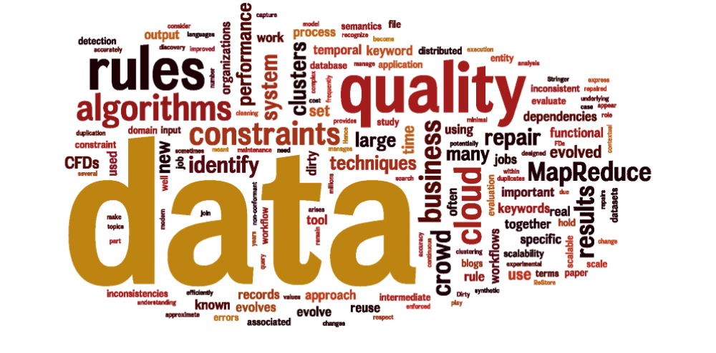
Computational Structures in Data Science
Lecture #1: Welcome to CS88!
UC Berkeley EECS Lecturer
Michael Ball
September 9, 2019
http://cs88.org

Slide 2
Welcome
We are all here to learn:
Knowledge(end) – Knowledge(start)
9/9/19
UCB CS88 Fa19 L1
2

Slide 3
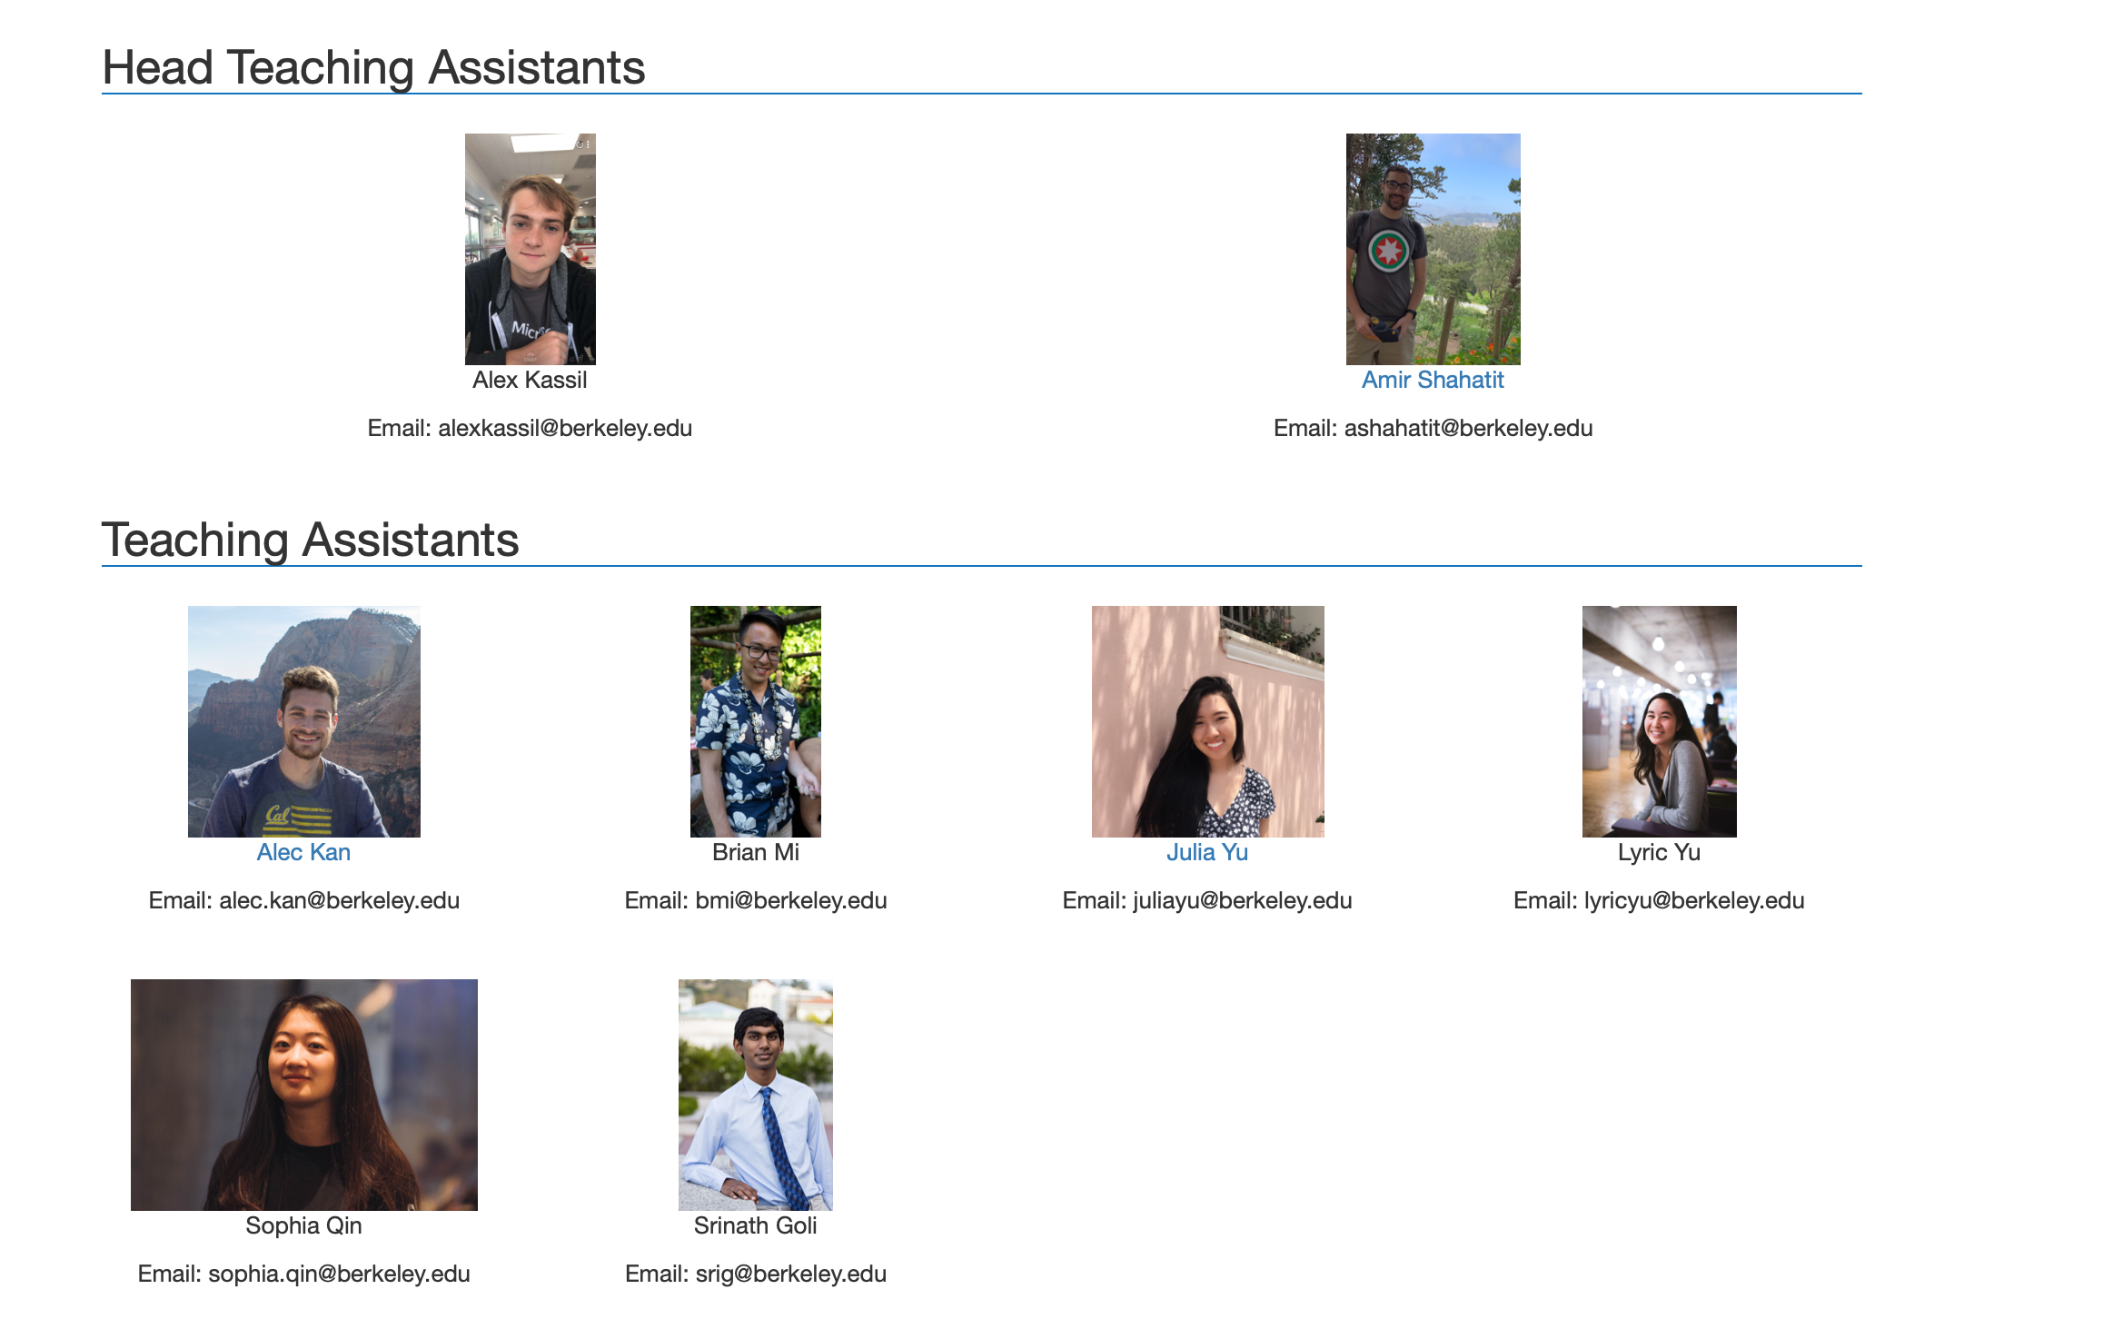
CS88 Team
UCB CS88 Fa19 L1

Slide 4
CS88 Team - me
Michael Ball
ball@Berkeley.edu – You’re best off by using Piazza! ☺
625 Soda Hall
http://michaelball.co – I don’t update this much…
It was great procrastination when I was a CS student.
Office hours: Tues 5:00-7:00pm @ 625 Soda
A few minutes after class
Things I do:
Intro CS Research
Tools, curriculum
Training TAs
Building Educational Software (Gradescope)
Tools for web accessibility
UCB CS88 Fa19 L1

Slide 5
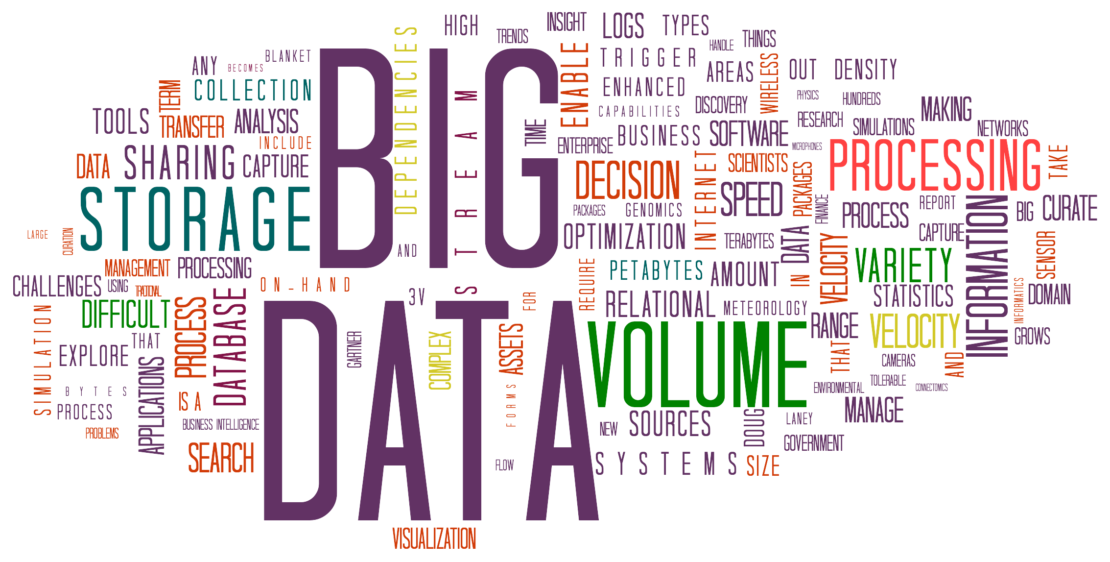

Goals today
Introduce you to
the field
the course
the team
Answer your questions
Big Ideas:
Abstraction
Data Type
UCB CS88 Fa19 L1
Notes:
Questions:
- Freshman/Soph vs Jr/Sen
- New to programming vs experienced
- CS10
- CS61A
- Might want to major? Minor? Just do some CS?
- Love c8 so far?

Slide 6
Announcements
Labs are Fridays – we do take attendance
Lab 1 is due tomorrow night
HW 1 is due Thurs night
CS Mentors Sections:
http://www.bit.ly/88csm1
UCB CS88 Fa19 L1
Notes:
Questions:
- Freshman/Soph vs Jr/Sen
- New to programming vs experienced
- CS10
- CS61A
- Might want to major? Minor? Just do some CS?
- Love c8 so far?

Slide 7
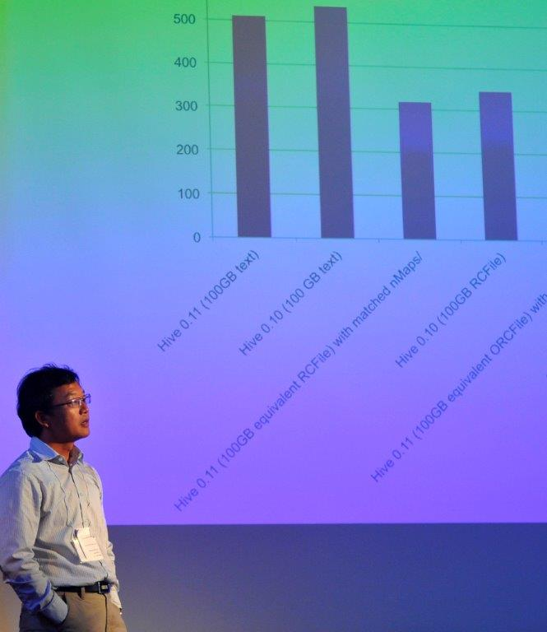
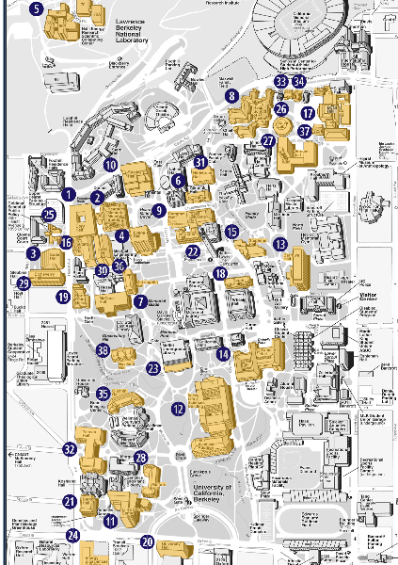

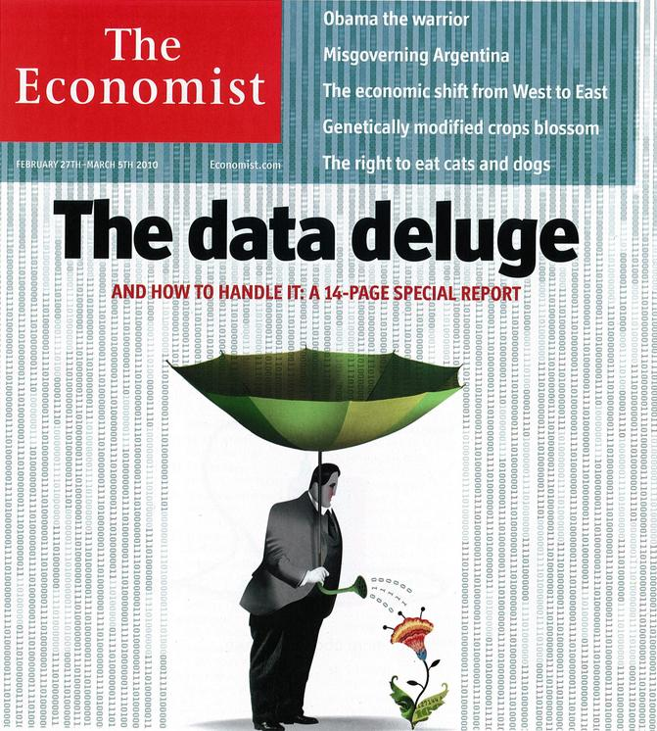
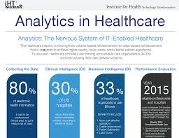
Data Science
UCB CS88 Fa19 L1

Slide 8
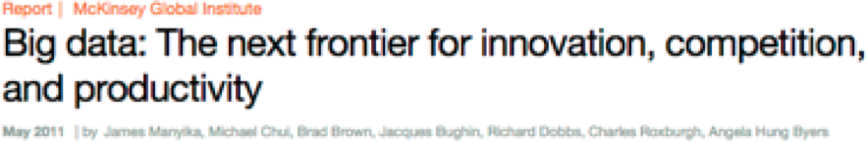
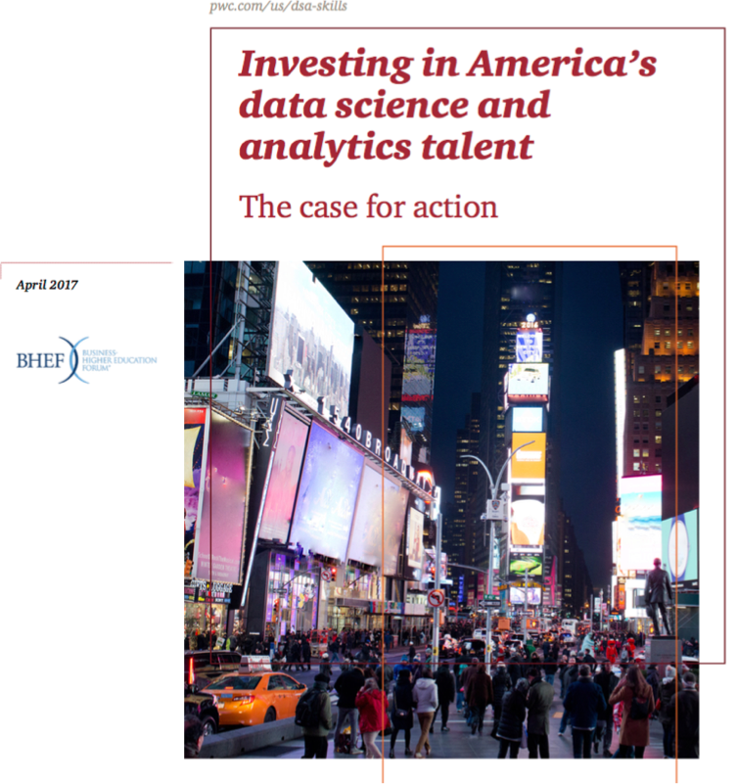
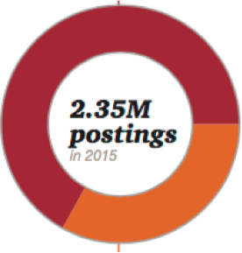
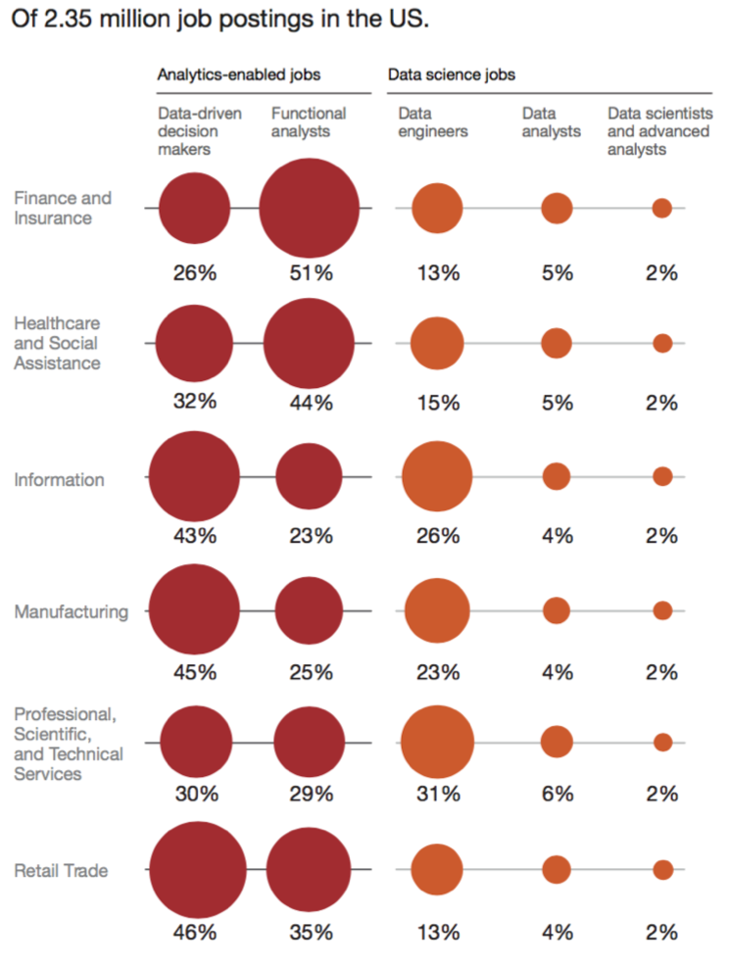


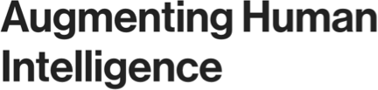
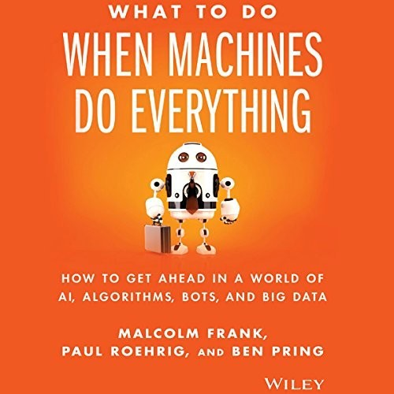
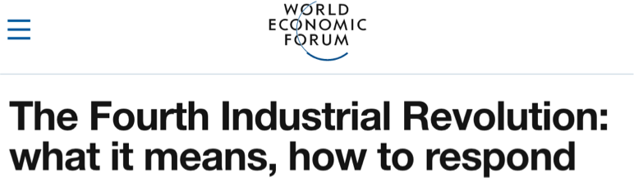
A National Challenge
Increasingly US jobs require data science and analytics skills. Can we meet the demand? The current shortage of skills in the national job pool demonstrates that business-as- usual strategies won’t satisfy the growing need. If we are to unlock the promise and potential of data and all the technologies that depend on it, employers and educators will have to transform.
By 2021, 69% of employers expect candidates with DSA skills to get preference for jobs in their organizations.
Only 23% of college and university leaders say their graduates will have those skills.
5/24/18
21st Century
8

Slide 9
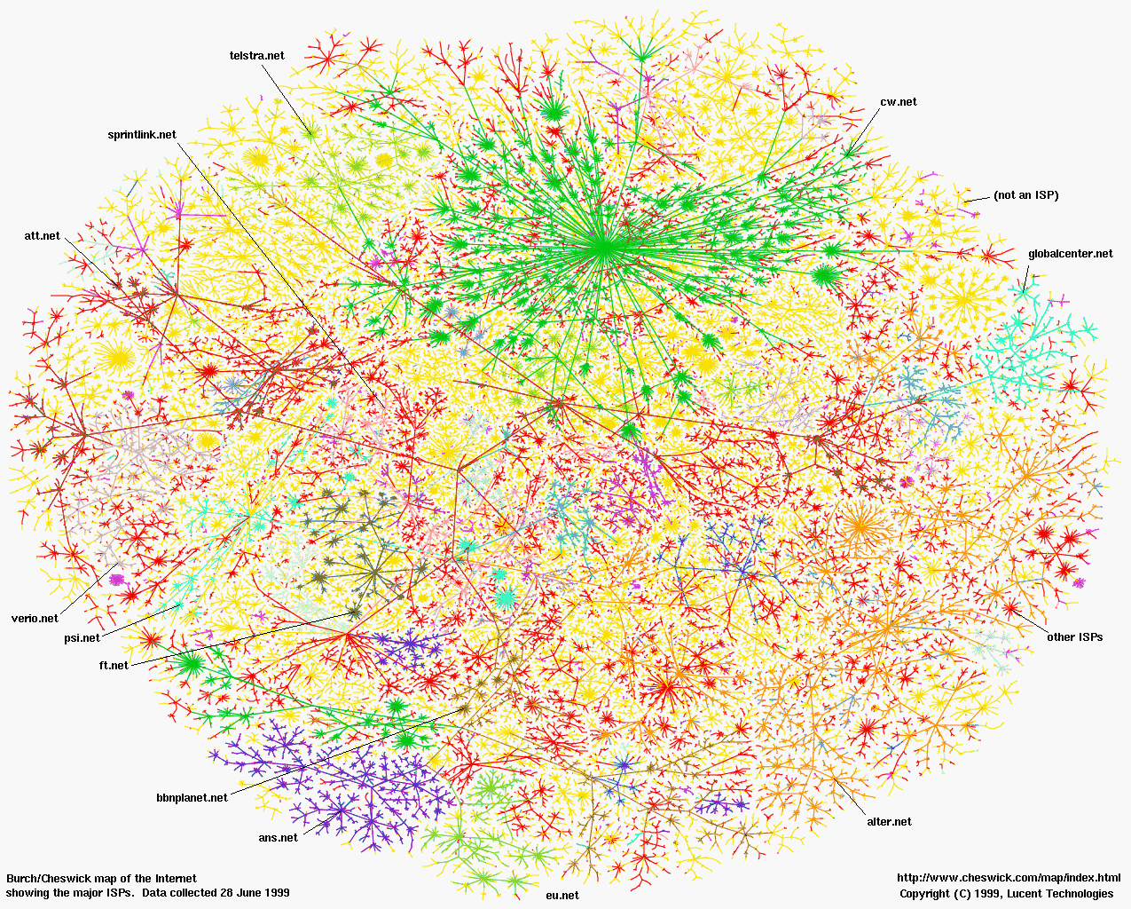
Greatest Artifact of Human Civilization …
UCB CS88 Fa19 L1

Slide 10
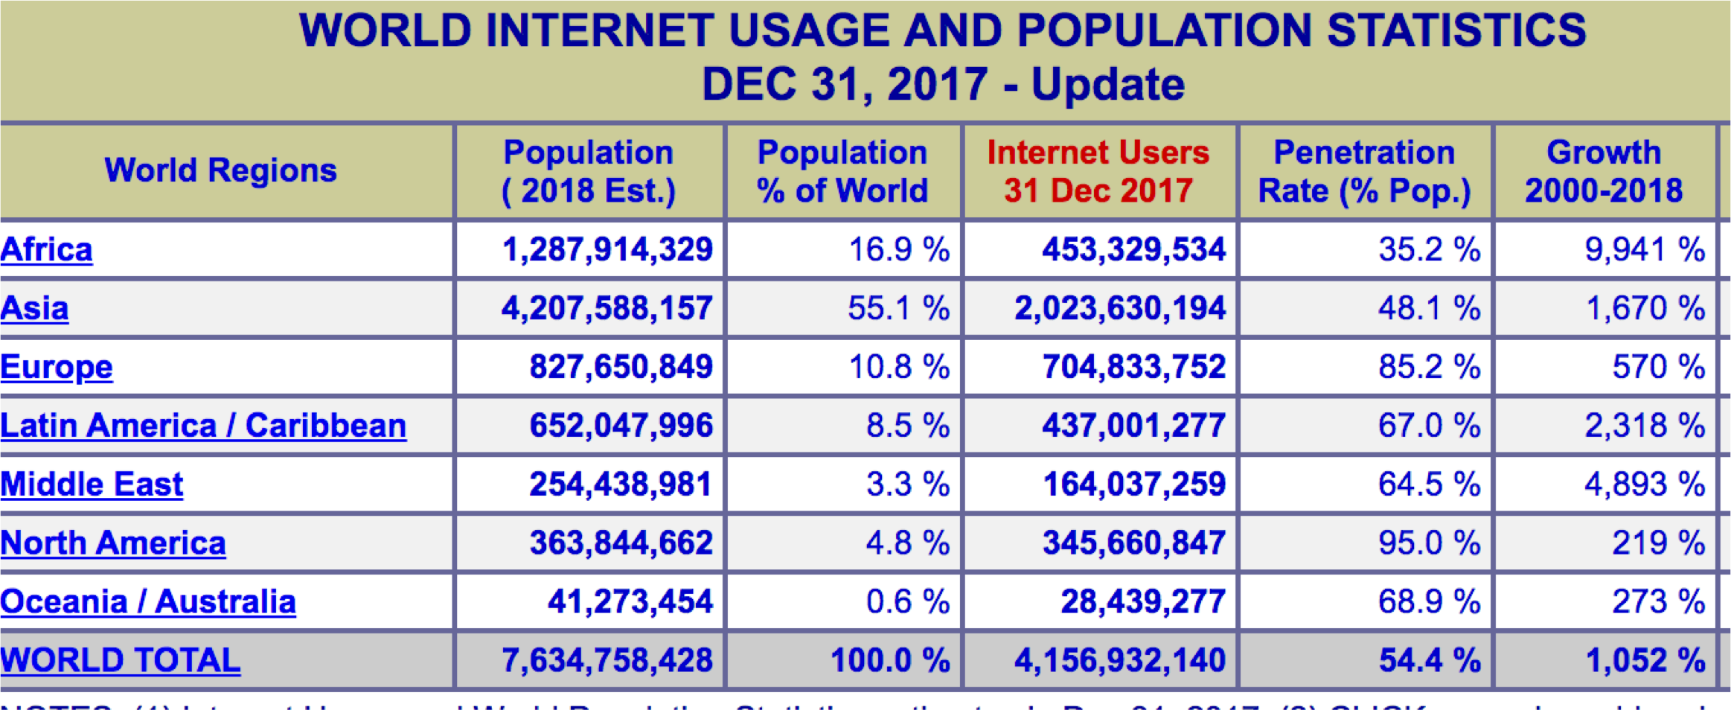
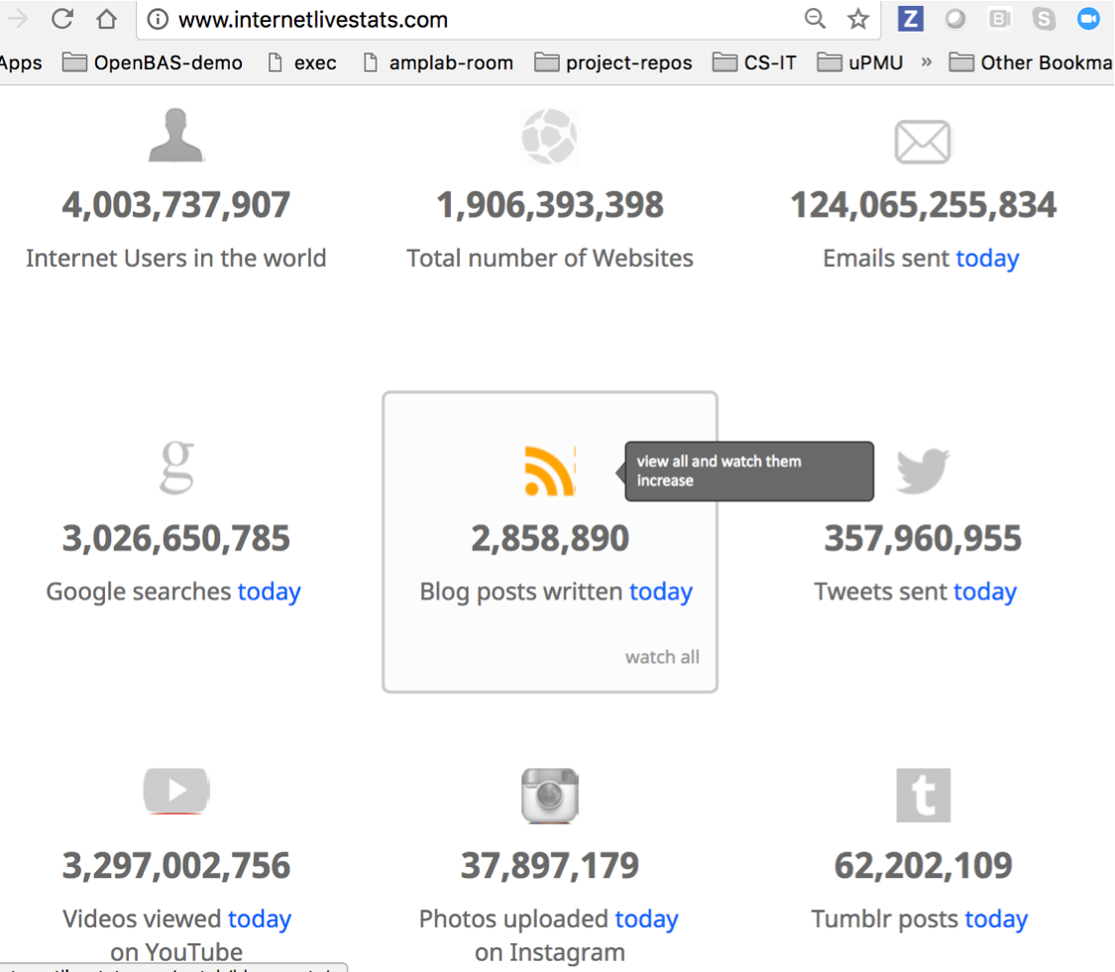
1/25/16
UCB CS88 Sp16 L1
11

Slide 11


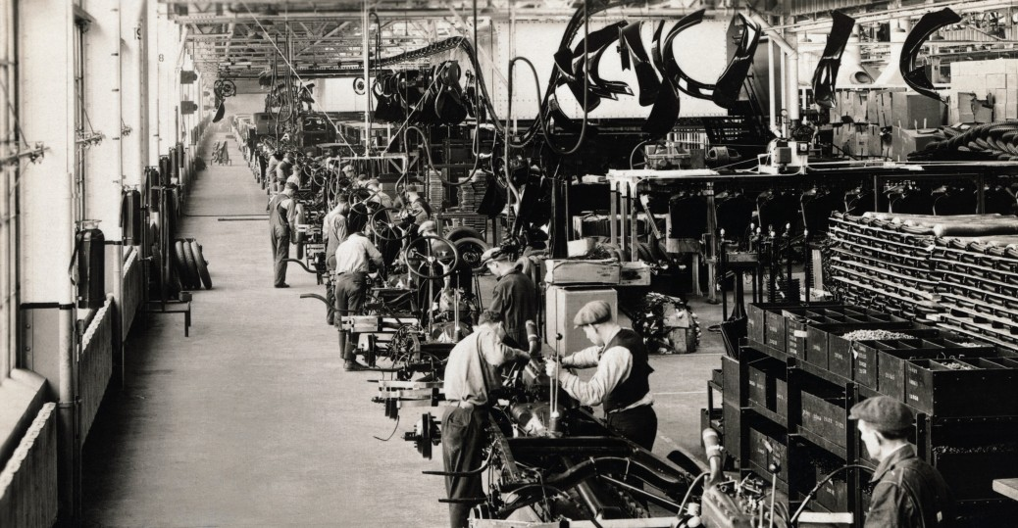
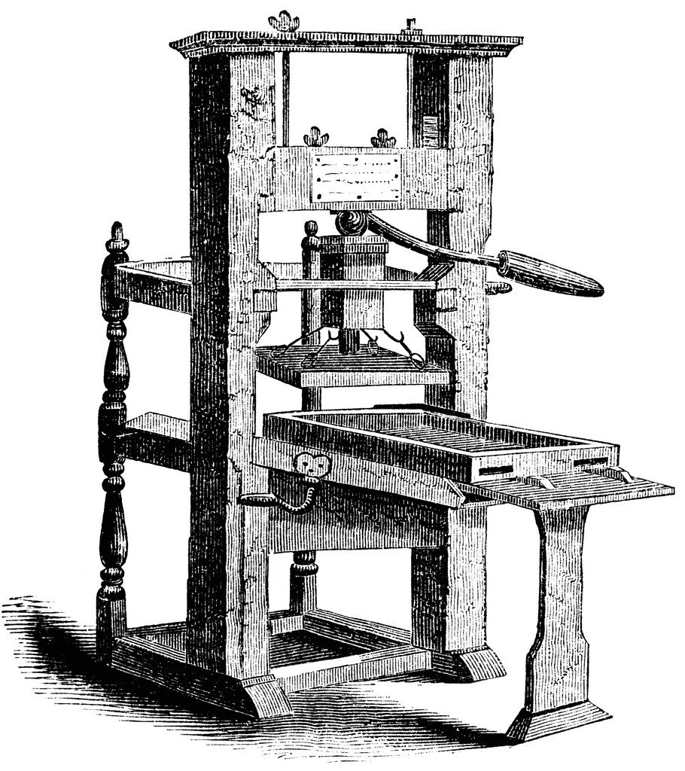
Era of Transformation
Connected
Industrial Revolution
Age of Enlighte nment
World
5/24/18
21st Century

Slide 12
A Connected World of Data
The world’s knowledge at our finger tips
Digitialization of life, industry and society
Intimately connected to billions of us, globally
Explosion of observational instruments
– Genomics, Microscopy, Astronomical, …
Vast Computational power to do analytics
Synthetic design exploration thru simulation
Machine reading of everything
Statistical machine learning algorithms to “discover” structure
5/24/18
21st Century

Slide 13


What if I could … ?
See the world’s digital footprints?
Read everything that’s ever been written?
Take it all in and dive down anywhere as far as the science can take me?
Learn the physical/chemical/biological
/sociological/neurological… models from the data?
Explore billions of designs and pick the one I want?
… ?
5/24/18
21st Century

Slide 14
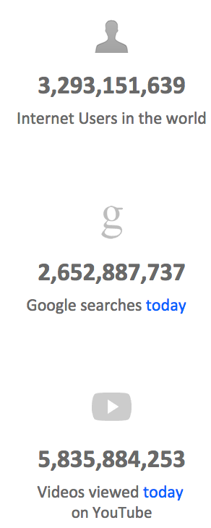

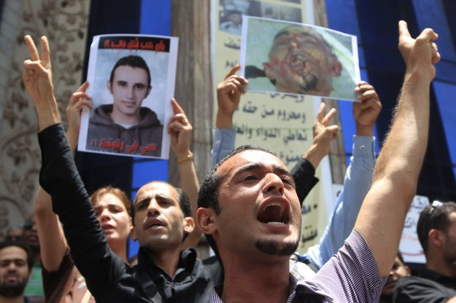
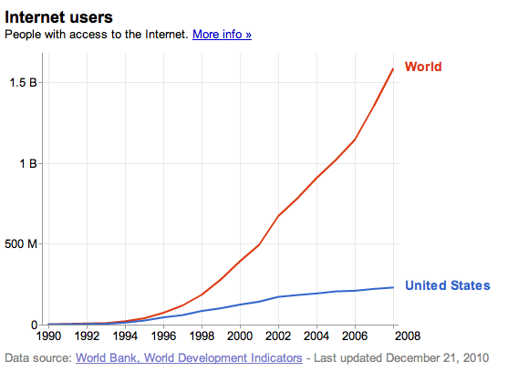
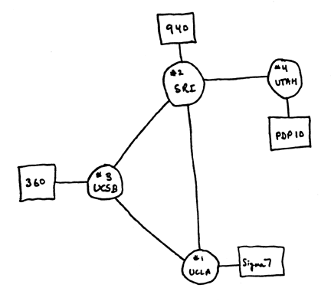
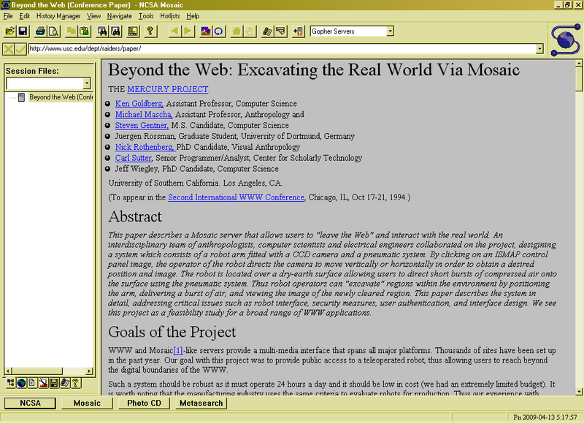
A Connected World
3.0 B 11/15
Internet
WWW
2.0 B 1/26/11
ARPANet
RFC 675 TCP/IP
HTTP 0.9
1969
1974
1990
2010
UCB CS88 Fa19 L1

Slide 15
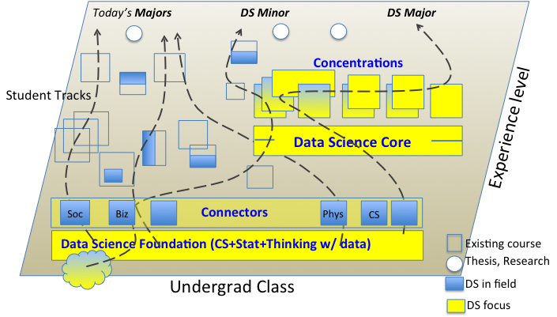
Data 8 – Foundations of Data Science
Computational Thinking + Inferential Thinking in the context of working with real world data
Introduce you to several computational concepts in a simple data-centered setting
Authoring computational documents
Tables
Within Python3 and “SciPy”
UCB CS88 Fa19 L1

Slide 16
CS88 – Computational Structures in Data Science
Deeper understanding of the computing concepts introduced in c8
Hands-on experience => Foundational Concept
How would you create what you use in c8 ?
Extend your understanding of the structure of computation
What is involved in interpreting the code you write ?
Deeper CS Concepts: Recursion, Objects, Classes, Higher-order Functions, Declarative programming, …
Managing complexity in creating larger software systems through composition
Create complete (and fun) applications
In a data-centric approach
UCB CS88 Fa19 L1

Slide 17
How does CS88 relate to CS61A ?
Interpretation
Thinking w/ Data
Working w/ Data
CS Concepts
and
Techniques
Statistics Concepts in a Computational Approach
CS Concepts
and
Techniques
Units
& Tools
Intro Programming
& Tools
Intro Programming
CS61A
DATA8
CS88
UCB CS88 Fa19 L1
Notes:
Cascade
C8
C8 + CS 88
C8 + CS88 + CS61B
CS minor
CS Major

Slide 18
Opportunities for students
c8
c8
CS88
c8 | CS88 | CS61B
CS minor
***
CS major
c8
cs61a
cs61a
1/25/16
UCB CS88 Sp16 L1

Slide 19
The Data Science Major
Computational & Inferential Depth
Modeling, Learning & Decision Making
Human Contexts & Ethics
Domain Emphasis
Individualized Upper Division
30 units
Probability
Data 100: Principles & Techniques of Data Science
Electives
Mathematics
Computing
Domain Emphasis
Foundational Lower Division
College Breadth & Electives
Data 8: Foundations of Data Science
19

Slide 20
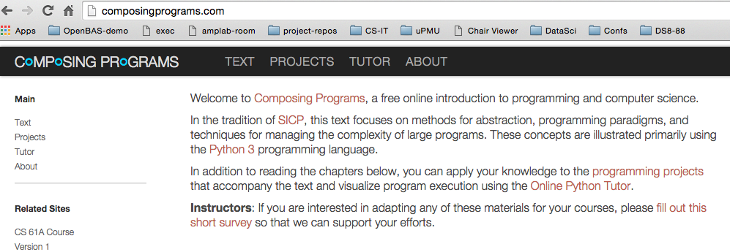
Course Structure
1 Lecture + 1 Lab/Discussion on Friday (!!!)
Lecture introduces concepts (quickly!), answers why questions.
Lab provides concrete detail hands-on
Homework (10) cements your understanding
Out Tuesdays, Due Next Thurs (~9 days)
Projects (2) put your understanding to work in building complete applications
Maps
Probably: Ants vs Some Bees
Readings: http://composingprograms.com
Same as cs61a
UCB CS88 Fa19 L1
Notes:
Course Policies:
- Learning: The purpose of this course is to learn something you don't
already know.
You should never feel bad for not understanding something yet.
I won't tolerate disrespectful or condescending comments.
If someone doesn't understand something, help them out.
- Community: You're encouraged to help each other;
One of the most important things you can learn in college is how to explain
- Course Staff: We are here to help you succeed, not to judge you.
We know that you're talented b/c you're at Berkeley
We know that you're able to work hard, and we're here to make
sure that working hard leads to the results you want.

Slide 21

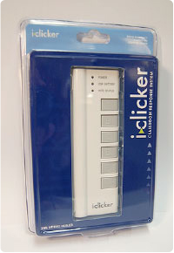
Course Culture
Learning
Community
Respect
Collaboration
Peer Instruction
UCB CS88 Fa19 L1

Slide 22
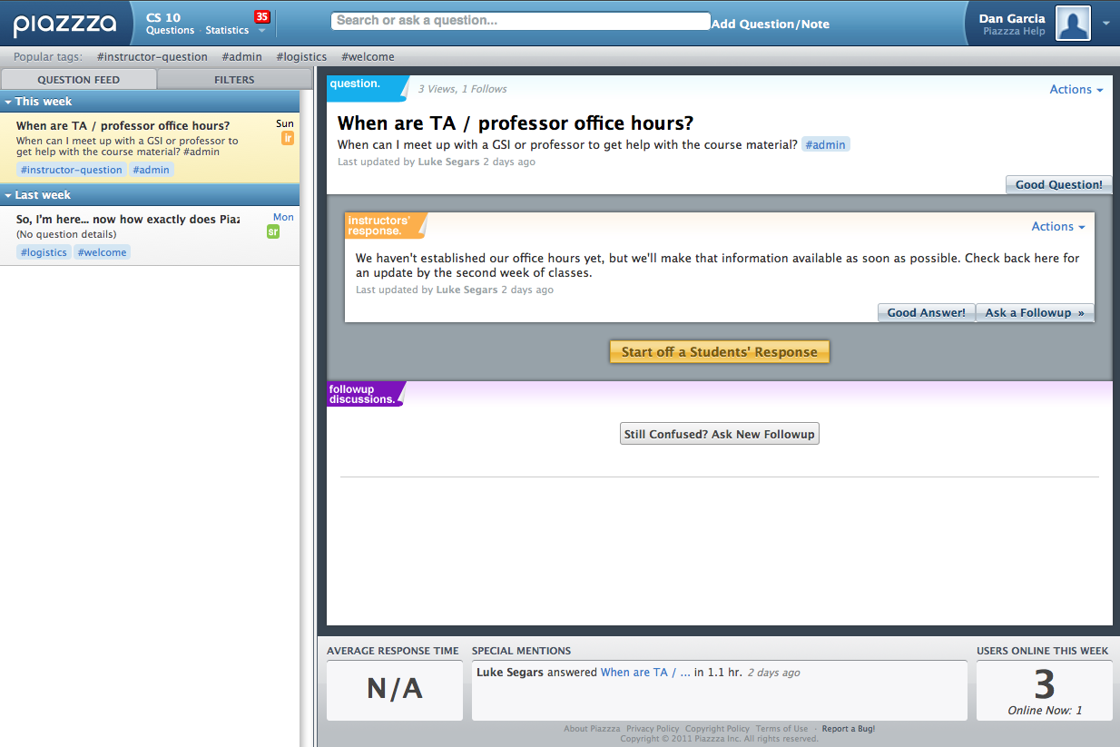
Piazza for {ask,answer}ing questions
UCB CS88 Fa19 L1

Slide 23
Where will we work?
Your laptop
Using an editor and a terminal
cs88.org
Datahub.berkeley.edu
Not as often, but an option
UCB CS88 Fa19 L1

Slide 24
iClicker Check In
How has lab gone so far?
A. Labs have gone fantastic!
B. Labs have gone alright…
C. Labs have gone very well…
D. I haven’t been to lab yet.
UCB CS88 Fa19 L1
Notes:
Questions:
- Freshman/Soph vs Jr/Sen
- New to programming vs experienced
- CS10
- CS61A
- Might want to major? Minor? Just do some CS?
- Love c8 so far?

Slide 25
iClicker Check In
Are you enrolled in Data 8?
A. I took if Fall 2018 or earlier
B. I took it Spring 2019
C. I’m taking it right now
D. I am trying to enroll in Data 8
E. I am not taking Data 8
UCB CS88 Fa19 L1
Notes:
Questions:
- Freshman/Soph vs Jr/Sen
- New to programming vs experienced
- CS10
- CS61A
- Might want to major? Minor? Just do some CS?
- Love c8 so far?

Slide 26
Pro-student Grading Policies
EPA
Rewards good behavior
Effort
E.g., Office hours, doing every single lab, hw, reading Piazza pages
Participation
E.g., Raising hand in lec or discussion, asking questions on Piazza
Altruism
E.g., helping other students in lab, answering questions on Piazza
You have 3 “Slip Days”
You use them to extend due date, 1 slip day for 1 day extension
You can use them one at a time or all at once or in any combination
They follow you around when you pair up (you are counted individually)
E.g., A has 2, B has 0. Project is late by 1 day. A uses 1, B is 1 day late

Slide 27

Abstraction
Detail removal
“The act of leaving out of consideration one or more properties of a complex object so as to attend to others.”
Generalization
“The process of formulating general concepts by abstracting common properties of instances”
Technical terms: Compression, Quantization, Clustering, Unsupervized Learning
Henri Matisse “Naked Blue IV”

Slide 28
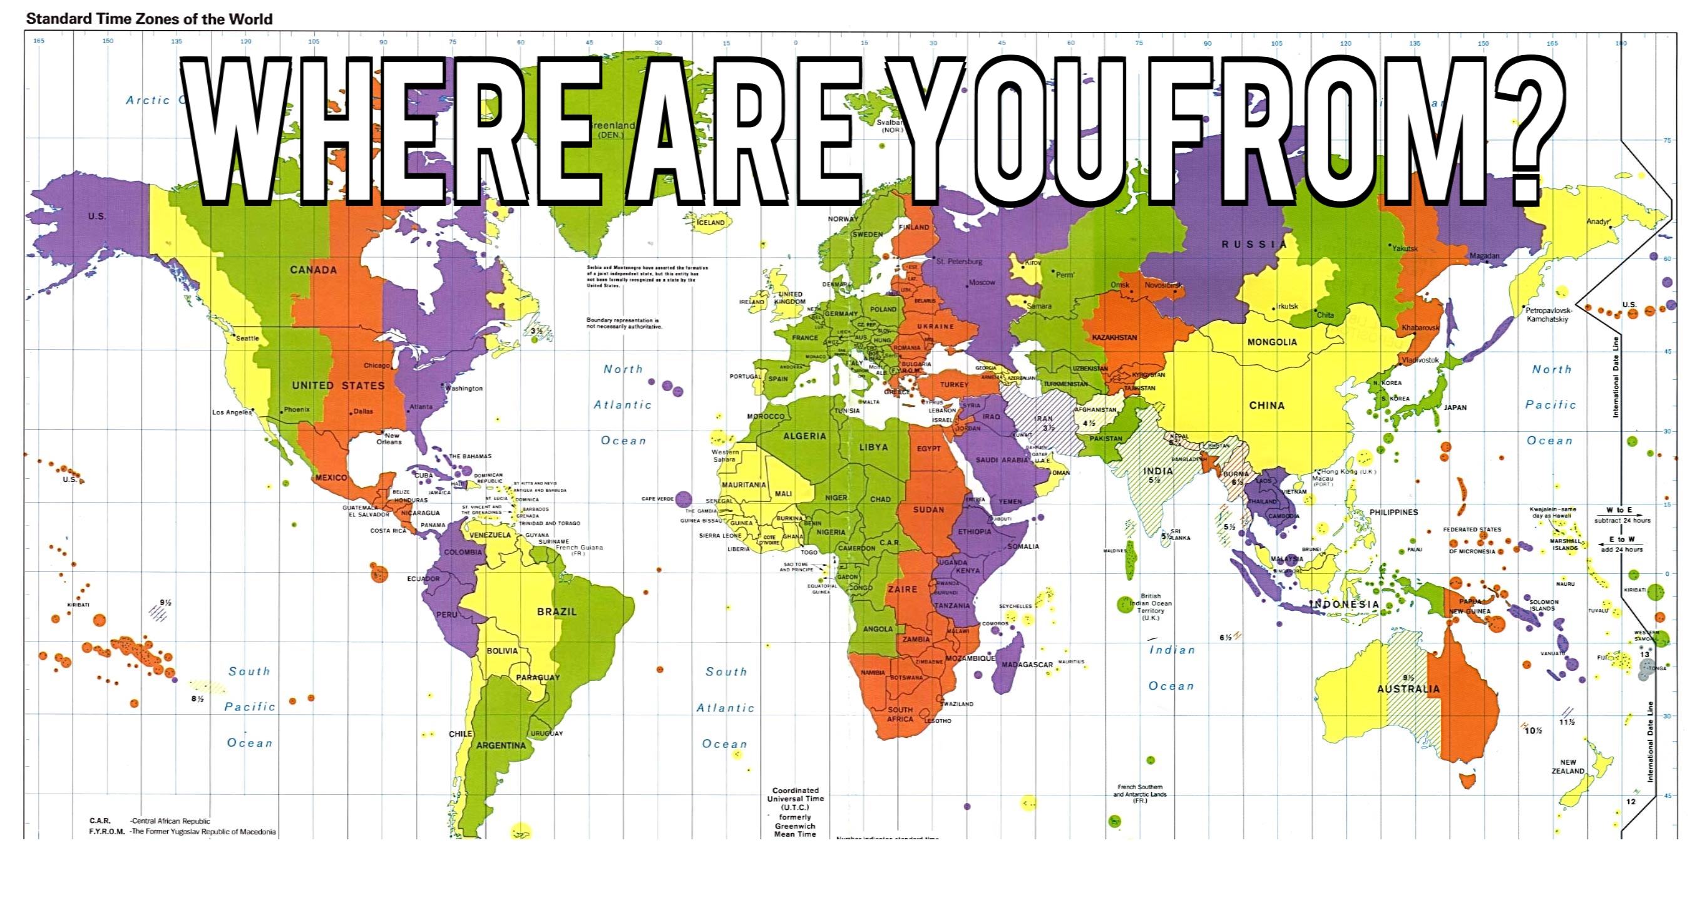
Experiment

Slide 29

Where are you from?
Possible Answers:
Planet Earth
Europe
California
The Bay Area
San Mateo
1947 Center Street, Berkeley, CA
37.8693° N, 122.2696° W
All correct but different levels of abstraction!

Slide 30
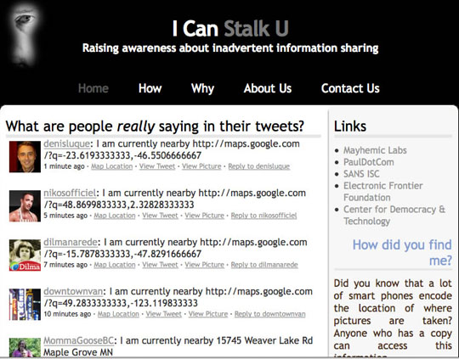
Abstraction gone wrong!

Slide 31
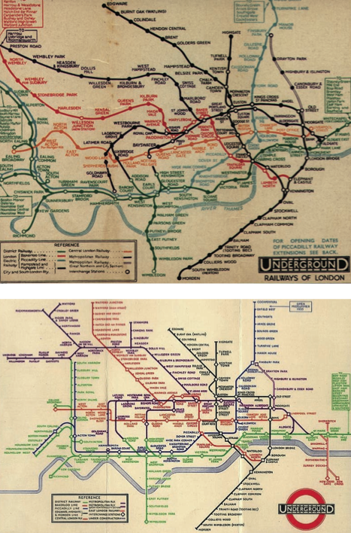
Detail Removal (in Data Science)
You’ll want to look at only the interesting data, leave out the details, zoom in/out…
Abstraction is the idea that you focus on the essence, the cleanest way to map the messy real world to one you can build
Experts are often brought in to know what to remove and what to keep!
The London Underground 1928 Map & the 1933 map by Harry Beck.

Slide 32
The Power of Abstraction, Everywhere!
Examples:
Functions (e.g., sin x)
Hiring contractors
Application Programming Interfaces (APIs)
Technology (e.g., cars)
Amazing things are built when these layer
And the abstraction layers are getting deeper by the day!
We only need to worry about the interface, or specification, or contract
NOT how (or by whom) it’s built
Above the abstraction line
Abstraction Barrier (Interface) (the interface, or specification, or contract)
Below the abstraction line
This is where / how / when / by whom it is actually built, which is done according to the interface, specification, or contract.

Slide 33
Abstraction: Pitfalls
Abstraction is not universal without loss of information (mathematically provable). This means, in the end, the complexity can only be “moved around”
Abstraction makes us forget how things actually work and can therefore hide bias. Example: AI and hiring decisions.
Abstraction makes things special and that creates dependencies. Dependencies grow longer and longer over time and can become unmanageable.

Slide 34
Abstraction in CS: Data Type
What’s this?
Real (or ideal) world
42
Computer representation
Notes:
Integers?, Whole Numbers?, Natural Numbers
What other data types are you already familiar with?
- rational
- reals
- complex
- strings
Which real numbers can you represent?

Slide 35
Data Types and Operations
Set of elements
with some internal representation
E.g. Integers, Floats, Booleans, Strings, …
Set of operations on elements of the type
e.g. +, *, -, /, %, //, **
==, <, >, <=, >=
Properties
Commutative, Associative, …
Expressions are valid well-defined sets of operations on elements that produce a value of a type
Notes:
Python

Slide 36
Lab and HW this week
Lab will get you more practice with functions in Python
Make sure you’ve done Lab 1
HW will give practice and explain subtleties of types, operators, and expressions
In a program development environment
What’s the difference between ‘==‘ and ‘=‘ ?
UCB CS88 Fa19 L1

Slide 37
Thoughts for the Wandering Mind
A binary digit (bit) is a symbol from {0,1}.
How many things can you represent with N bits?
How many things can you represent with 1 digit (0-9)?
2 digits? 6 digits?
UCB CS88 Fa19 L1

